Slide 1
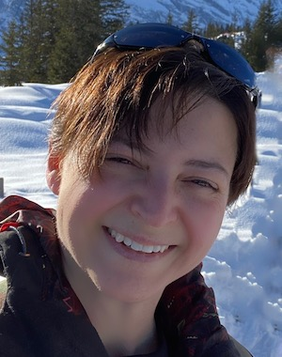
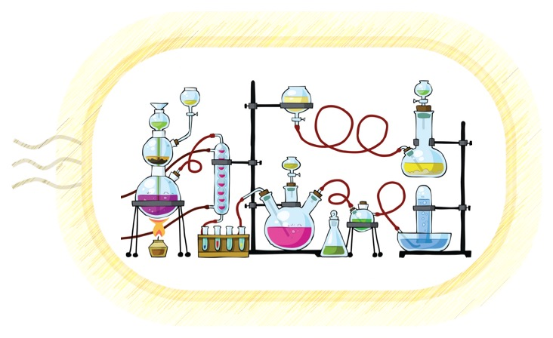
C³ Lecture
Aula III time 9:30-10.30
Dipartimento di Chimica «Giacomo Ciamician»
Via Selmi 2
Teams
7th November 2022
Chair: Prof. Walter Cabri
"Evolving Biocatalysis to increase industrial uptake"
Prof. Francesca Paradisi
Professor of Sustainable Pharmaceutical Chemistry, University of Bern, CH
Il seminario potrà essere seguito anche tramite Teams al seguente link:
https://teams.microsoft.com/l/meetup-join/19:meeting_NzJlZGE4ZmQtMzU0Yi00OWYwLWJhMzktZjkxYTg3MGU2Zjky@thread.v2/0?context=%7B%22Tid%22:%22e99647dc-1b08-454a-bf8c-699181b389ab%22,%22Oid%22:%22bd0a5fff-617b-413b-b98c-4650fd7c65d3%22%7D
Contacts: i.rivalta@unibo.it; segreteria.c3@unibo.it https://centri.unibo.it/c3/en

